Slide 1
FILTER DESIGN – rectangular, hamming

Slide 2

FIR Filter Design
FIR – h
IIR – [b, a]
Filter Specifications
Design procedure
FIR Filter Design | IIR Filter Design
Linear Phase
Stable
 | Efficient Implementation when N is large (as FIR)
2

Slide 3

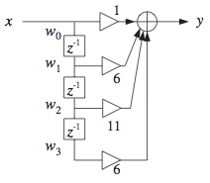
FIR Filter

Slide 4



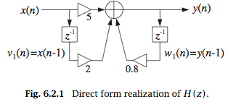

IIR Filter

Slide 5
FIR Filter Design
FIR – h
IIR – [b, a]
Filter Specifications
Design procedure
FIR Filter Design | IIR Filter Design
Linear Phase
Stable
 | Efficient Implementation when N is large (as FIR)
5

Slide 6
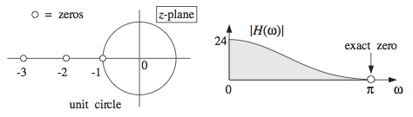
Zeros => Spectrum
6

Slide 7



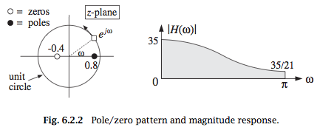



Poles and Zeros => Spectrum
6

Slide 8
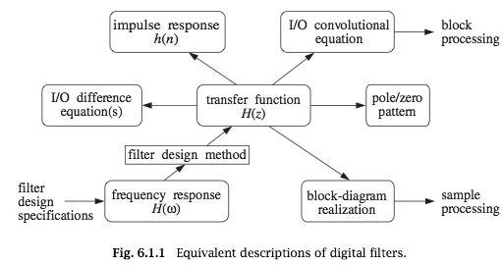
Transfer functions

Slide 9
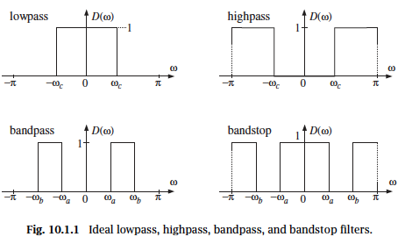

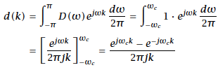

FIR Filter Design
9

Slide 10

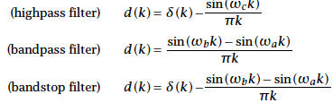

FIR Filter Design
10

Slide 11
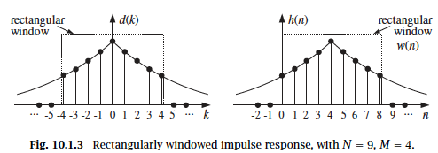

Rectangular Window Method
11

Slide 12




Rectangular Window Method
12

Slide 13
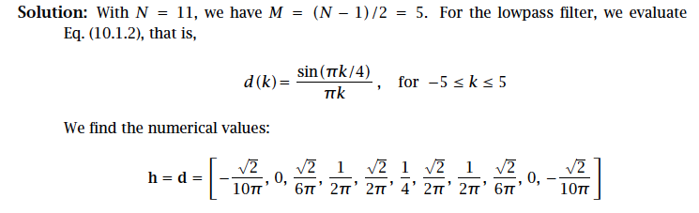

Slide 14
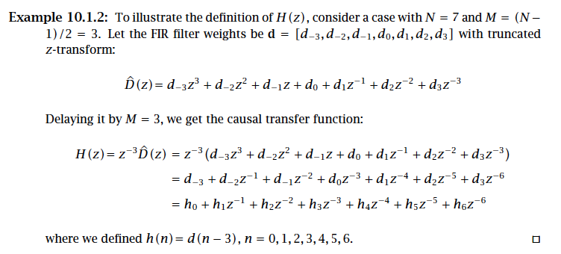

Slide 15
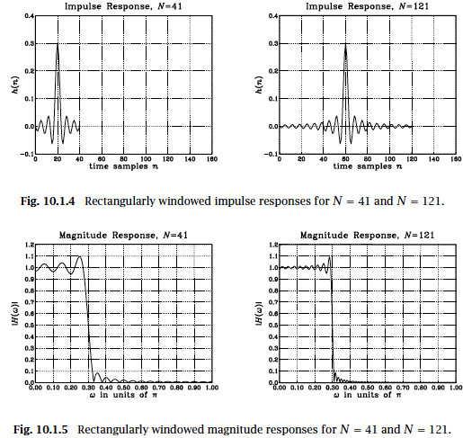
Rectangular Window Method
15

Slide 16
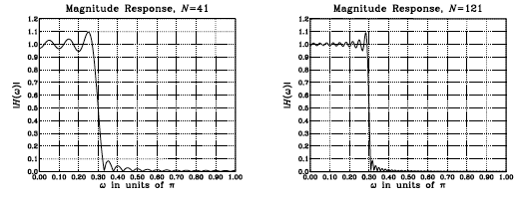

Rectangular Window Method
16

Slide 17

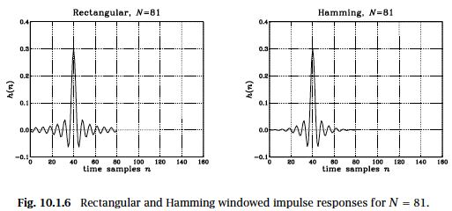
Hamming Window Method
17

Slide 18
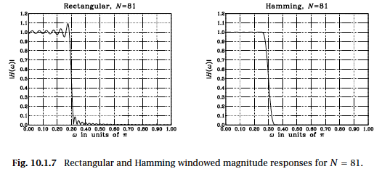

Hamming Window Method
18

Slide 19
Conclusion
Reference: Orfanidis – chapter 10 FIR Filter design
Filter Specs
Rectangular, Hamming – Cut off frequency
Next Lecture: Kaiser –

